Slide 1

SENG2260 Human Computer Interaction Assignment 1 – Low Fidelity Prototype
Team Resistance
Name | Student ID | Email
Chuxiong Li | C3318463 | chuxiong.li@uon.edu.au
Emma Wyllie | C3355522 | emma.wyllie@uon.edu.au
Kurt McRae | C3304405 | kurt.mcrae@uon.edu.au
Kan Zheng | C3344867 | kan.zheng@uon.edu.au
Jason Phua | C3059196 | jason.phua@uon.edu.au

Slide 2
Briefing – Art View Augmented Reality App
Hi, thank you for your time participating in this test. I am Jason from Team Resistance, and we are made up of Emma, Kurt, Kan and Chuixong. While I am facilitating, they will be taking observations during the session.
I would like to start by outlining what we are going to be doing today. Firstly, I will cover your participation/privacy and then some background information on our applications purpose. After this we will ask you to perform some tasks on our art gallery Augmented Reality App. Once complete we will ask for your thought about your experience with our program.
Participation/privacy
Before we get started, I would like to highlight that participation in this session is voluntary and you are free at any time to stop participating. We are doing this usability testing to see how users interact with our application, and not to test your abilities, there are no right or wrong answers.
In terms of privacy we will not be collecting your details such as your name and will be assigning you an ID number for data identification. We do intend to do a video recording of this session to aid in the development of observations if you have any objections please let us know.
Background
ArtView is an Augmented Reality App that has been designed to enhance the user experience when attending art galleries. It is expected that user will be wearing a head-mounted display (Microsoft HoloLens 2) which will project a user interface info the user’s field of view. They will be able to interact with this interface via touch (hand tracking) and speech (voice recognition). The interface you will see is a low fidelity prototype made for the Newcastle Art Gallery.
When using the ArtView, imagine that you are using the app on your own, in a real-world setting. Please think aloud as you are using our app as it helps us know your thoughts. For example, where you are navigating on the page, why you are clicking somewhere, what you expect to happen when you do click. If you have questions, feel free to ask me during the scenarios. Please be as honest as possible, if something does not make sense or is not working right, then let us know.

Slide 3
Scenarios and task descriptions
1) Find where you are in the art gallery and navigate to an artwork. | 2) Search for a specific artwork or type of artwork. | 3) Browse artwork information placeholders.
In this scenario you are looking for your location in the gallery and then looking for directions to an artwork Tasks: Find your location in the gallery using the map function Search for an artwork within gallery to navigate to Navigate to a chosen artwork search results Follow directions toward artwork Reach artwork | In this scenario you are looking for a specific artwork or type of artwork and viewing results Tasks: Open the search function menu Input the artwork name or type View results Select artwork for more information Navigate to artwork | In this scenario you want to browse artwork information as you walk around the gallery Tasks: Turn on place card feature Browse artwork place cards View detailed information about an artwork Perform search for specific artwork

Slide 4
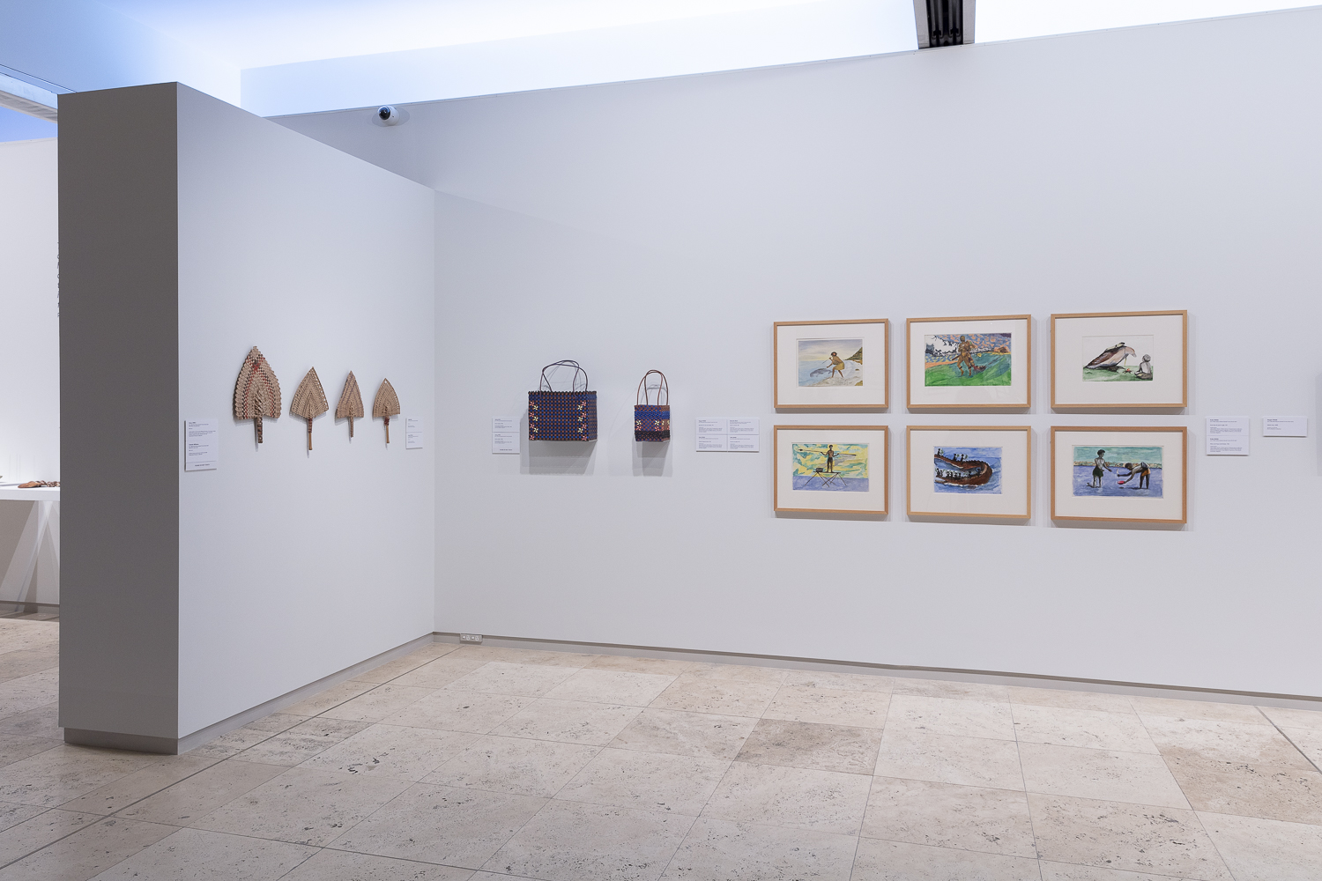
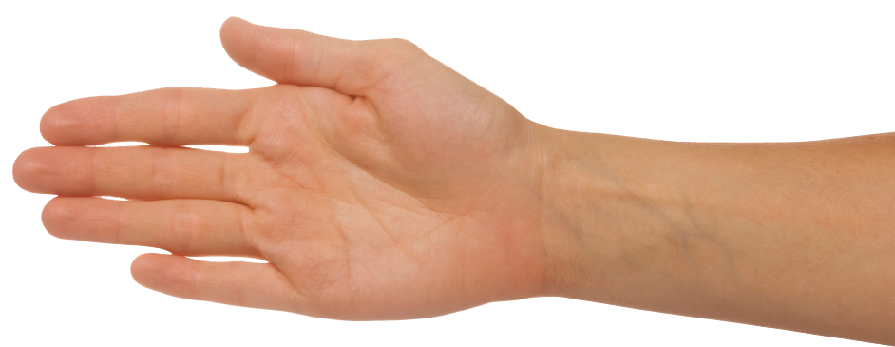
Task:
Open main menu
Notes:
Main menu

Slide 5
Task:
Open gallery app
ART
VIEW
Notes:
Main menu

Slide 6



Task:
Select option
Art info
Location
Search
Art info
Navigate
Search
Notes:
Main menu
Art info – go to slide 10
Navigate – got to slide 16
Search – go to slide 7

Slide 7



Task:
Perform search for specific art work or type of art e.g. sculpture
Sculpture
Virtual keyboard
Notes:
Perform voice search or type using virtual keyboard

Slide 8

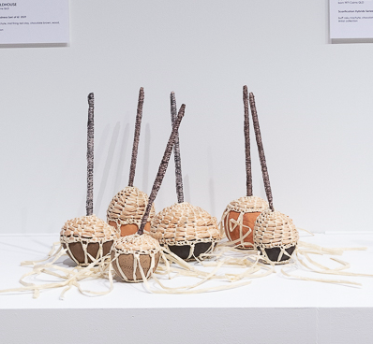

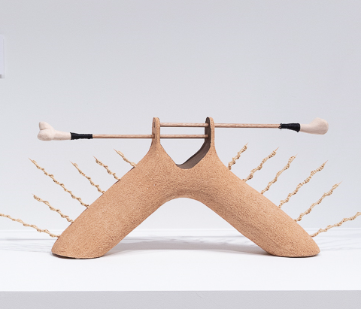
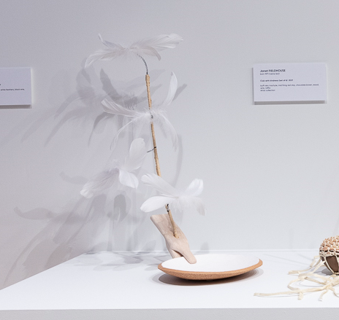
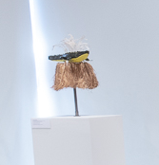
Task:
View search results
View directions to sea sticks artwork
Back
Title: Sea sticks
Description:
Title: ZXC
Description:
Title: DFG
Description:
Title: DFG
Description:
Notes:
Sea sticks go to slide 20

Slide 9
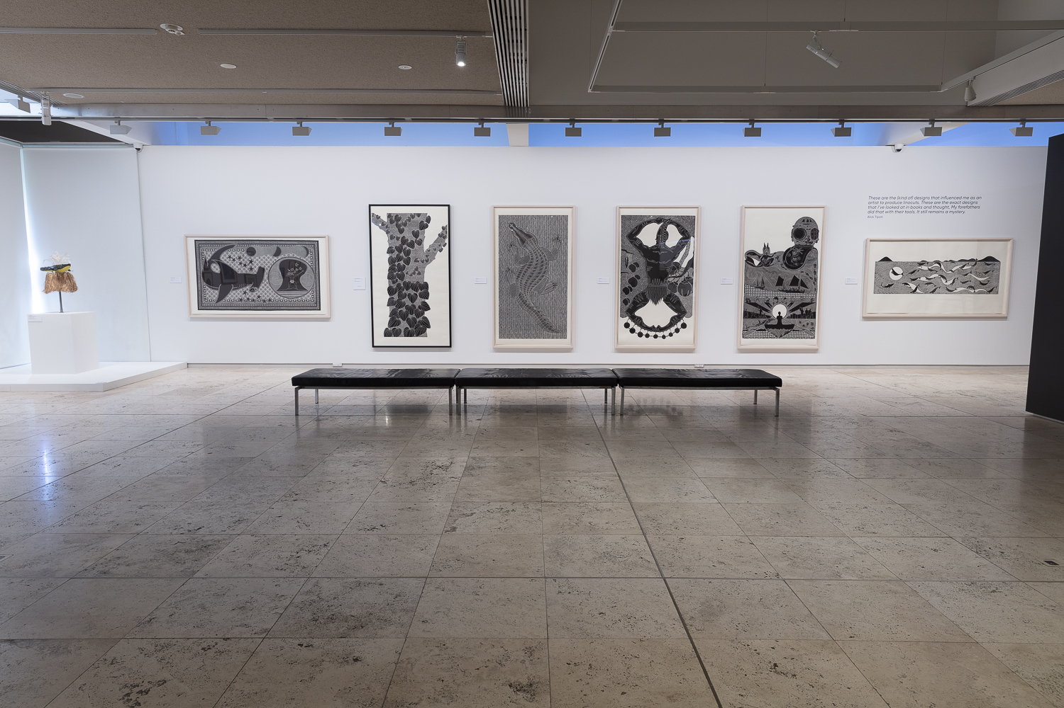
Task:
View information about artworks which are currently in view
Art info
Navigate
Search

Slide 10
Task:
View information about artworks which are currently in view
Close
Turn on artwork place cards

Slide 11
Task:
View information about artworks which are currently in view
Select an artwork
Title
Artist
Date
Description
Price
Title
Artist
Date
Description
Price
Title
Artist
Date
Description
Price
Title
Artist
Date
Description
Price
Title
Artist
Date
Description
Price
Title
Artist
Date
Description
Price
Title
Artist
Date
Description
Price

Slide 12
Task:
View detailed information about an artwork
Bring up main menu
Artwork Title
Artist
This is a placeholder detailed description of a particular artwork. Information which can be found here could include things such as: an artist's comments on a piece, the context of a piece, the date and location of production, the artist's influences/style, etc.
Back
Placeholder image of Artist

Slide 13
Task:
Search for an artwork which is currently in view
Title
Artist
Date
Description
Price
Title
Artist
Date
Description
Price
Title
Artist
Date
Description
Price
Title
Artist
Date
Description
Price
Title
Artist
Date
Description
Price
Title
Artist
Date
Description
Price
Title
Artist
Date
Description
Price
Art info
Navigate
Search

Slide 14
Task:
View artwork information based on search criteria
Title
Artist
Date
Description
Price
Title
Artist
Date
Description
Price
Title
Artist
Date
Description
Price
Title
Artist
Date
Description
Price
Title
Artist
Date
Description
Price
Title
Artist
Date
Description
Price
Title
Artist
Date
Description
Price
Sculpture
Virtual keyboard

Slide 15
Task:
View artwork information based on search criteria
--End--
Title
Artist
Date
Description
Price

Slide 16
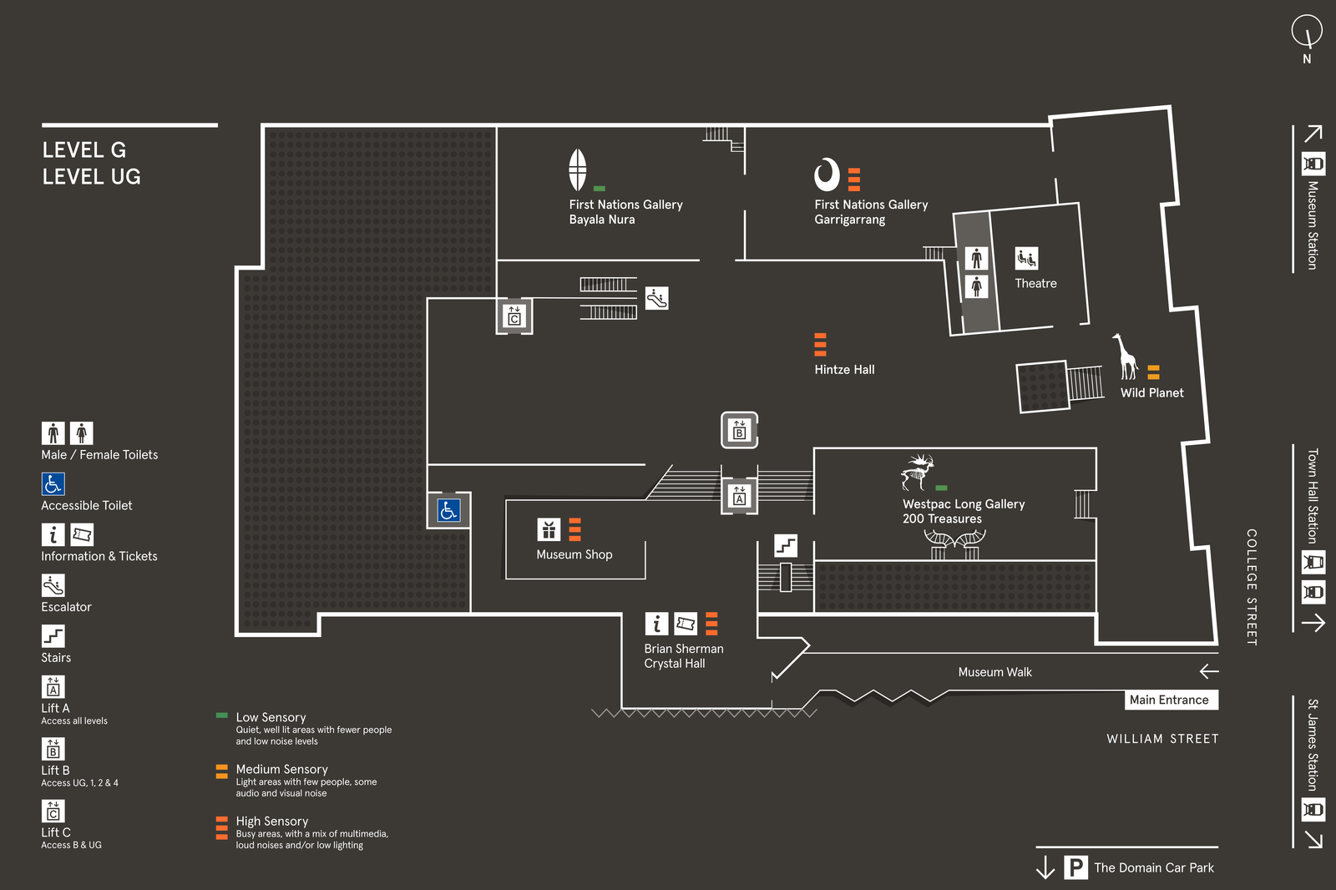
Task:
Locate where you are in the art gallery
Perform a search for an artwork to navigate to
Sea dragon
You are here

Slide 17
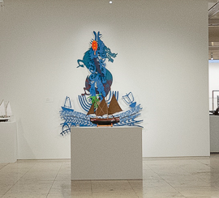
Task:
Navigate to search result – Sea Dragon
Sea dragon
Go to
You are here
Sea Dragon

Slide 18
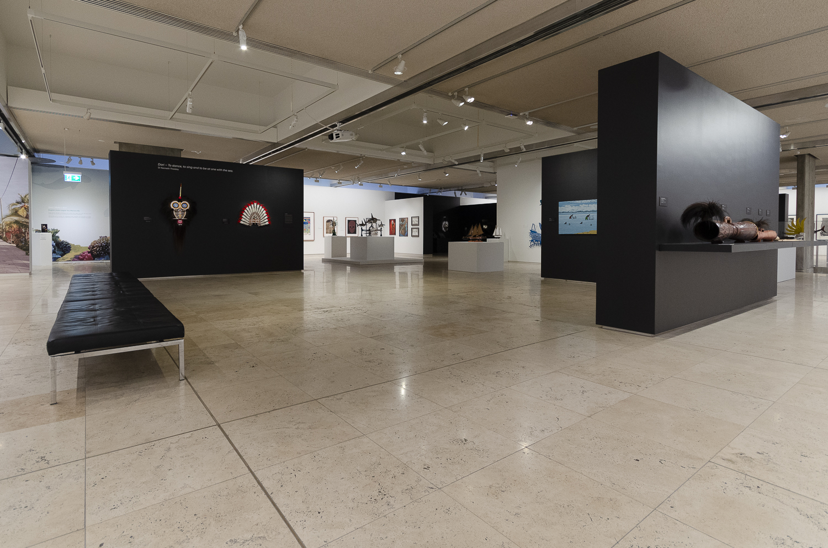
Task:
Follow direction arrows

Slide 19
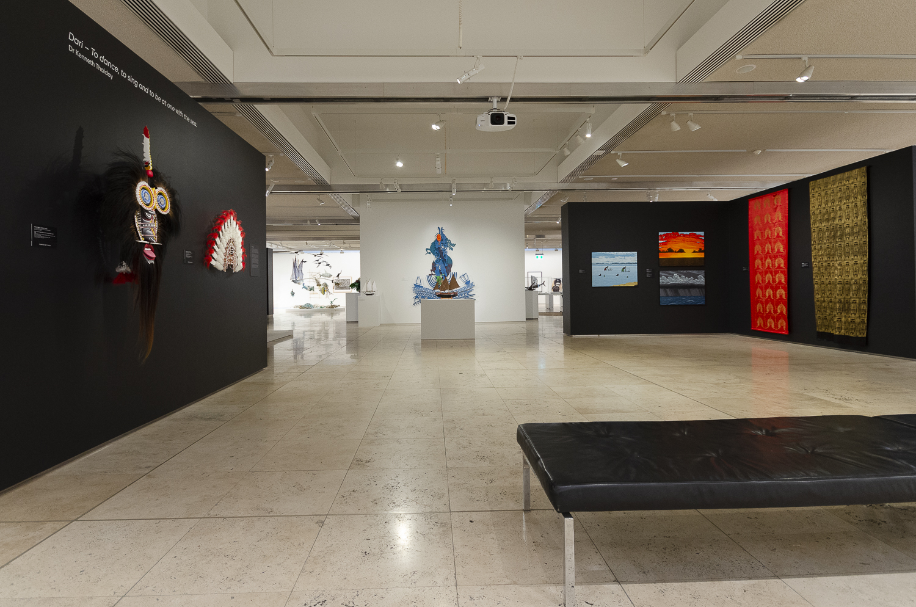
Task:
Follow direction arrows
Reach selected artwork
--End--

Slide 20
Task:
Navigate to search result – Sea sticks
Sea sticks
You are here
Go to
Sea sticks

Slide 21
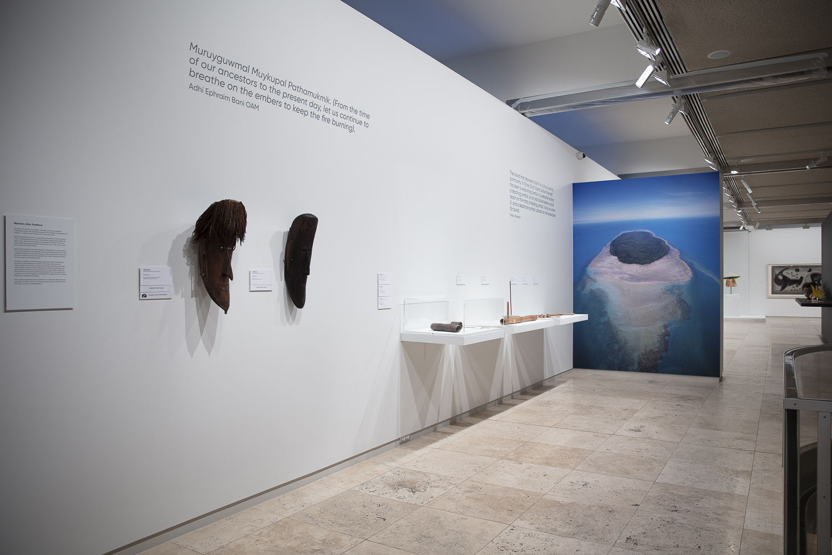
Task:
Follow direction arrows

Slide 22
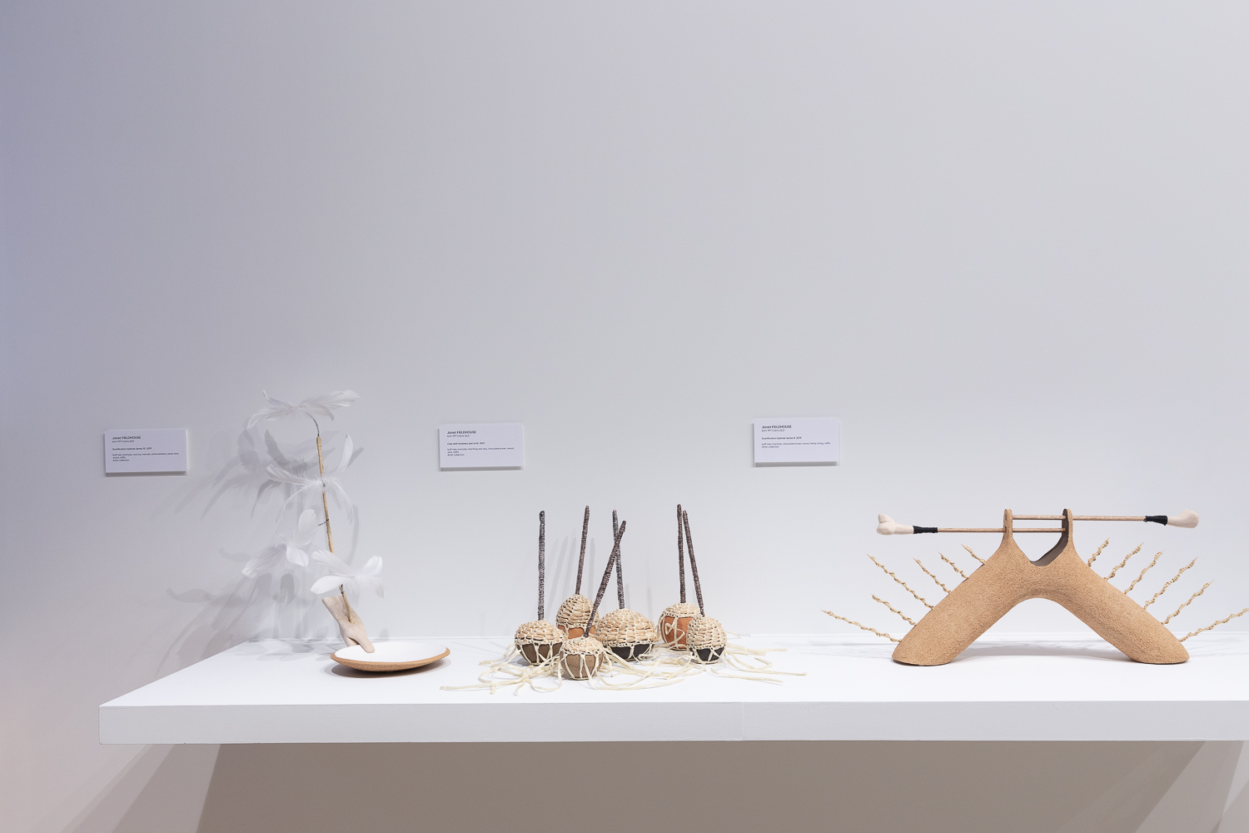
Task:
Reach selected artwork
--End--

Slide 23

Reference icons

